Slide 1
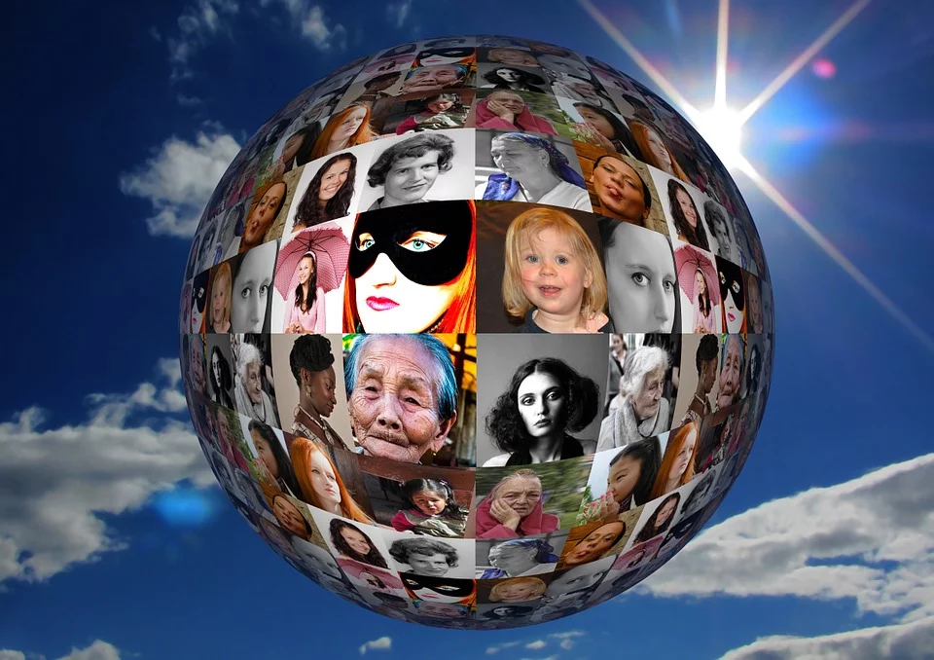
International Women’s Day
The 8th March is International Women’s Day, but why does this day exist?
Credit: geralt (pixabay.com)
Notes:
Whether it’s getting presents, eating lots of lovely food, or simply being off school, for many of us the end of the year is a time filled with happiness and excitement.
However, then we get to January – we have to get up on the still cold, dark, mornings, come to school, think about all the homework we have or haven’t done, and often don’t have something to look forward to like we did before the holidays.

Slide 2
We are going to watch a BBC clip that tells us a Quick History of International Women’s Day.
As we watch, think about how far women’s rights have developed since the very first international women’s day
Credit: geralt (pixabay.com)
https://www.bbc.co.uk/programmes/p072ytss
Notes:
Whether it’s getting presents, eating lots of lovely food, or simply being off school, for many of us the end of the year is a time filled with happiness and excitement.
However, then we get to January – we have to get up on the still cold, dark, mornings, come to school, think about all the homework we have or haven’t done, and often don’t have something to look forward to like we did before the holidays.

Slide 3
So, women are treated equally now, right? We are going to watch a clip from BBC Two programme, Politics Live.
As we watch, think about why we must still fight for the rights of women.
Credit: geralt (pixabay.com)
https://www.bbc.co.uk/programmes/p072tw4g
Notes:
Whether it’s getting presents, eating lots of lovely food, or simply being off school, for many of us the end of the year is a time filled with happiness and excitement.
However, then we get to January – we have to get up on the still cold, dark, mornings, come to school, think about all the homework we have or haven’t done, and often don’t have something to look forward to like we did before the holidays.

Slide 4
Both across the world and here in the UK, women are oppressed in both obvious and not so obvious ways.
How can we make sure that we contribute to making the world a fair and equal place for everyone?
Credit: geralt (pixabay.com)
https://www.bbc.co.uk/programmes/p072tw4g
Notes:
Whether it’s getting presents, eating lots of lovely food, or simply being off school, for many of us the end of the year is a time filled with happiness and excitement.
However, then we get to January – we have to get up on the still cold, dark, mornings, come to school, think about all the homework we have or haven’t done, and often don’t have something to look forward to like we did before the holidays.

Slide 5
PSHE idea - Class debate:
‘In the UK today, gender inequality is not a major issue.’
Print and use the debate planning sheet on the next slide.
Credit: geralt (pixabay.com)
https://www.bbc.co.uk/programmes/p072tw4g
Notes:
Whether it’s getting presents, eating lots of lovely food, or simply being off school, for many of us the end of the year is a time filled with happiness and excitement.
However, then we get to January – we have to get up on the still cold, dark, mornings, come to school, think about all the homework we have or haven’t done, and often don’t have something to look forward to like we did before the holidays.

Slide 6
