Slide 1
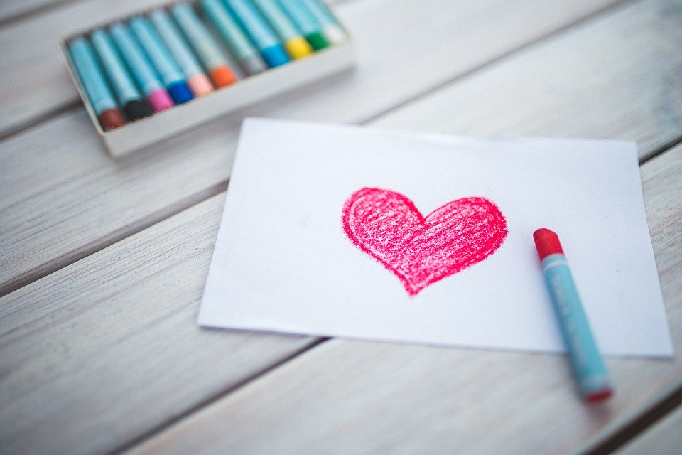
Valentine’s Day
What is Valentine’s Day?
What words would you associate with it?
Credit: Karolina Grabowska (pixabay.com)
Notes:
Whether it’s getting presents, eating lots of lovely food, or simply being off school, for many of us the end of the year is a time filled with happiness and excitement.
However, then we get to January – we have to get up on the still cold, dark, mornings, come to school, think about all the homework we have or haven’t done, and often don’t have something to look forward to like we did before the holidays.

Slide 2
Valentine’s Day
Where did Valentine’s day come from?
We are going to watch a clip from BBC Newsround, ‘What is Valentine's Day and how did it start?’
Credit: Karolina Grabowska (pixabay.com)
https://www.bbc.co.uk/newsround/16945378
Notes:
Whether it’s getting presents, eating lots of lovely food, or simply being off school, for many of us the end of the year is a time filled with happiness and excitement.
However, then we get to January – we have to get up on the still cold, dark, mornings, come to school, think about all the homework we have or haven’t done, and often don’t have something to look forward to like we did before the holidays.

Slide 3
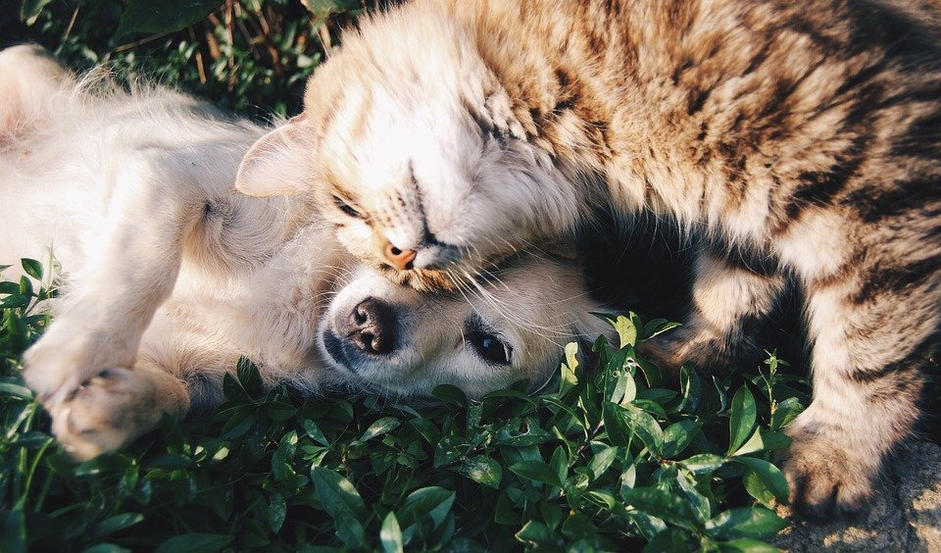
Valentine’s Day
So, we know how it came about, but why do people still celebrate it today?
Our relationships with others make us happy! We are going to a clip from BBC Three, ‘Are Relationships the Key To Happiness?’
As we watch, think about how far you agree with the views expressed!
Credit: Free-Photos (pixabay.com)
https://www.bbc.co.uk/bbcthree/clip/ec8872e1-79da-441f-b9f8-197503238c92
Notes:
Whether it’s getting presents, eating lots of lovely food, or simply being off school, for many of us the end of the year is a time filled with happiness and excitement.
However, then we get to January – we have to get up on the still cold, dark, mornings, come to school, think about all the homework we have or haven’t done, and often don’t have something to look forward to like we did before the holidays.

Slide 4
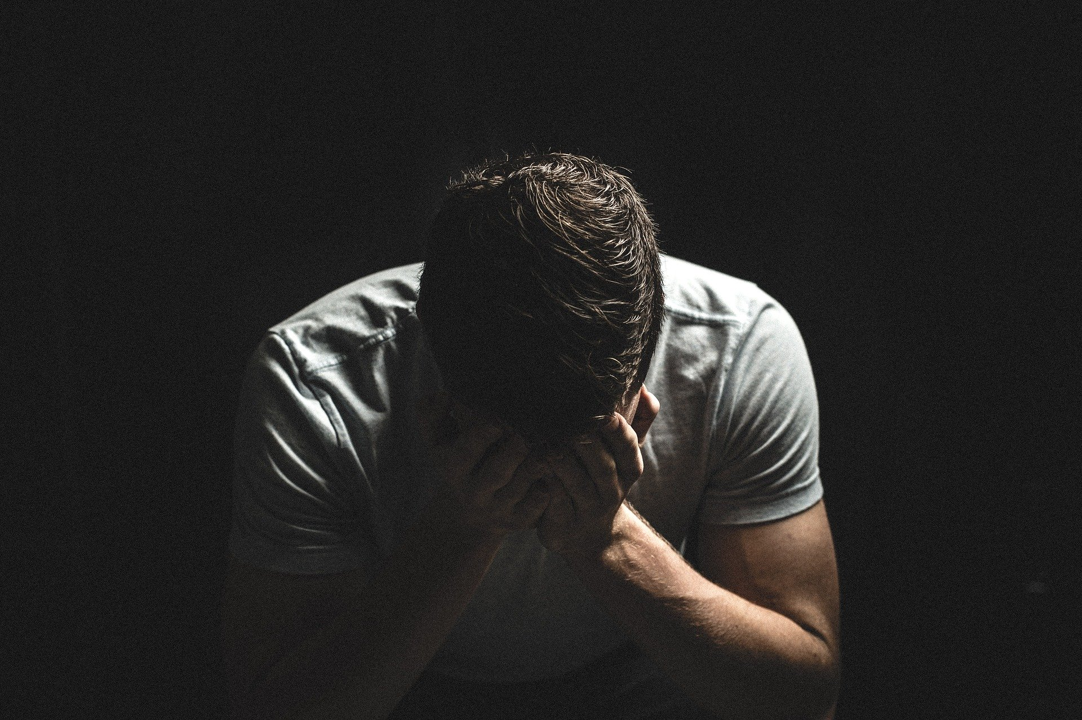
Valentine’s Day
However, are relationships always good for us?
We are going to watch a clip from a BBC Three programme, Abused by my girlfriend.
As we watch, what signs can you see of an unhealthy relationship?
Credit: StockSnap (pixabay.com)
https://www.bbc.co.uk/iplayer/episode/p0700912/abused-by-my-girlfriend
Start time: 5:00 – 6:20
Notes:
Whether it’s getting presents, eating lots of lovely food, or simply being off school, for many of us the end of the year is a time filled with happiness and excitement.
However, then we get to January – we have to get up on the still cold, dark, mornings, come to school, think about all the homework we have or haven’t done, and often don’t have something to look forward to like we did before the holidays.

Slide 5
Valentine’s Day
Should Alex feel worried about his relationship with Jordan?
Why? Why Not?
Credit: StockSnap (pixabay.com)
https://www.bbc.co.uk/iplayer/episode/p0700912/abused-by-my-girlfriend
Start time: 5:00 – 6:20
Notes:
Whether it’s getting presents, eating lots of lovely food, or simply being off school, for many of us the end of the year is a time filled with happiness and excitement.
However, then we get to January – we have to get up on the still cold, dark, mornings, come to school, think about all the homework we have or haven’t done, and often don’t have something to look forward to like we did before the holidays.

Slide 6
Valentine’s Day
Over the course of their 5 year relationship, Jordan abused Alex both mentally and physically, stabbing him, pouring boiling water over him, and more. Bedfordshire Police described Alex’s case as one of the most extreme cases of domestic violence they had ever dealt with.
When doctors examined him, he was told he was just ten days away from death.
Does this shock you?
Why? Why not?
Credit: StockSnap (pixabay.com)
https://www.bbc.co.uk/iplayer/episode/p0700912/abused-by-my-girlfriend
Start time: 5:00 – 6:20
Notes:
Whether it’s getting presents, eating lots of lovely food, or simply being off school, for many of us the end of the year is a time filled with happiness and excitement.
However, then we get to January – we have to get up on the still cold, dark, mornings, come to school, think about all the homework we have or haven’t done, and often don’t have something to look forward to like we did before the holidays.

Slide 7
Valentine’s Day
Any relationship will have ups can have ups and downs, but you should always feel safe and secure within it.
Credit: Karolina Grabowska (pixabay.com)
If you feel worried about any of your relationships, talk to someone you trust!
Credit: StockSnap (pixabay.com)
Notes:
Whether it’s getting presents, eating lots of lovely food, or simply being off school, for many of us the end of the year is a time filled with happiness and excitement.
However, then we get to January – we have to get up on the still cold, dark, mornings, come to school, think about all the homework we have or haven’t done, and often don’t have something to look forward to like we did before the holidays.

Slide 8
Valentine’s Day
Further PSHE ideas
Class discussion: why is it so important that we feel safe and secure in our relationships with others?
Credit: Karolina Grabowska (pixabay.com)
Print the class discussion planning sheet on the next slide.
Credit: StockSnap (pixabay.com)
Notes:
Whether it’s getting presents, eating lots of lovely food, or simply being off school, for many of us the end of the year is a time filled with happiness and excitement.
However, then we get to January – we have to get up on the still cold, dark, mornings, come to school, think about all the homework we have or haven’t done, and often don’t have something to look forward to like we did before the holidays.

